Slide 1
SGD and its Extension
R. Chopin Weinstein
rchopin@Outlook.com

Slide 2
Outline
Stochastic Gradient Descent Algorithm (SGD)
Stochastic Approximation: Robbins & Monro Algorithm
Basic GD / SGD Method
Hamiltonian Monte Carlo (HMC)
Hamiltonian Dynamics & Hamiltonian Equation
L-Leapfrog Method
Basic HMC Method (Brief)
Stochastic Hamiltonian Monte Carlo (SG-HMC)
The No-U-Turn Sampler(NUTS)
Exact Hamiltonian Monte Carlo (E-HMC) with Auxiliary-Variable
Extension Topic: Riemannian Manifold
Stochastic Gradient Langevin Dynamics (SGLD)
Langevin Dynamics
Stochastic Gradient Fisher Scoring (SGFS)
Bernstein-von Mises Theorem and Approximation (Extension: Cromwell’s Rule)
Fisher Scoring & Fisher Information
SGD as Approximate Bayesian Inference
SDE & Ornstein-Uhlenbeck process
Constant Stochastic Gradient Descent algorithm

Slide 3








Stochastic Approximation & SGD
Robbins & Monro Algorithm & Gradient Descent
A very starting but crucial Algorithm: introduced by Robbins & Monro, year 1951.
Presenting a methodology for solving a root finding problem, where the function is represented as an expected value.
$$Y=h\left(x\right)+ε$$
From root finding to optimization.
$$Y_{t}=h\left(x\right)+ε_{t}$$
Newton Method
$$x_{t+1}=x_{t}−a_{t}∗({N(θ}_{t}) − α)$$
Stochastic Gradient Descent Algorithm
Based on traditional Gradient Descent algorithm. In order to make a optimization problem more time-efficient when dealing with large amount of observations, SGD comes out. Moreover, based on SGD, many adaptation has been made recently to tackle different problems. It is called “stochastic” because samples are selected randomly (or shuffled) instead of as a single group (as in gradient descent).

Slide 4
Stochastic Approximation & SGD
Stochastic Gradient Descent Algorithm
When our learning rate is constant, that is to say, it does not vary from time t to t+1, the SGD has serval parameters to tune:
Minibatch Size
Learning Rate / Preconditioning Matrix

Slide 5


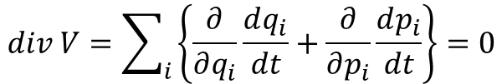


Hamiltonian Monte Carlo (HMC)
Hamiltonian Dynamics & Hamiltonian Equation (Fundamental knowledge of today’s topic)
In physics, we define the total energy of a closed system as the sum of Potential Energy and Kinetic Energy. So, the total energy is always constant and we would like to define it by function Hamiltonian(x, p), or in short H(x, p).
$$\frac{dp}{dt}=− \frac{∂H}{∂q}=− \frac{∂U(q)}{∂q}$$
$$H\left(q, p, t\right)=U\left(q\right)+K(p)$$
Hamiltonian Equation
$$\frac{dq}{dt}=+ \frac{∂H}{∂p}= + \frac{∂K(p)}{∂p}$$
Kinetic Energy
Potential Energy
Consider it in a very intuitive way:
q indicates its location.
p indicates its momentum.
$$V=(\frac{dq}{dt}, \frac{dp}{dt})$$
Divergence of phase space
$$div V=\sum_{i}{\left\{\frac{∂}{∂q_{i}}\frac{dq_{i}}{dt}+\frac{∂}{∂p_{i}}\frac{dp_{i}}{dt}\right\}=0}$$

Slide 6
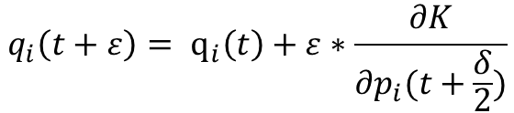


Hamiltonian Monte Carlo (HMC)
L-Leapfrog Method (Fundamental knowledge of today’s topic)
Update Location Parameter and Momentum Parameter at a specified sequence. Leapfrog integration is equivalent to updating positions x(t) and velocities v(t) at interleaved time points, staggered in such a way that they "leapfrog" over each other.
$$p_{i}\left(t+ \frac{ε}{2}\right)= p_{i}\left(t\right)− \frac{ε}{2}∗\frac{∂U}{∂q_{i}(t)}$$
$$q_{i}\left(t+ε\right)= q_{i}\left(t\right)+ε∗\frac{∂K}{∂p_{i}(t+\frac{δ}{2})}$$
$$p_{i}\left(t+ε\right)= p_{i}\left(t\right)− \frac{ε}{2}∗\frac{∂U}{∂q_{i}(t+ε)}$$
Take a half step in time to update the Momentum variable.
Take a full step in time to update the Position variable.
Take the remaining half step in time to finish updating the momentum variable.
Phase space of Hamiltonian Function and its two important properties.
By running the algorithm L times to calculate the Location and Momentum
yields an “L-Leapfrog Method”.

Slide 7




Hamiltonian Monte Carlo (HMC)
Hamiltonian Function
Basic Hamiltonian Monte Carlo
The methods define a Hamiltonian function in terms of the target distribution from which we desire samples — the potential energy—and a kinetic energy term parameterized by a set of “momentum” auxiliary variables. Based on simple updates to the momentum variables, one simulates from a Hamiltonian dynamical system that enables proposals of distant states.
Intuitive Thinking: total energy in a closed system is always constant.
What we interested.
Mass Matrix, usually set to I.
Log-posterior Function
HMC considers generating samples from a joint distribution of (theta; r) defined by:
Artificially
constructed.
To propose samples, HMC simulates the Hamiltonian dynamics (Hockey Puck):

Slide 8
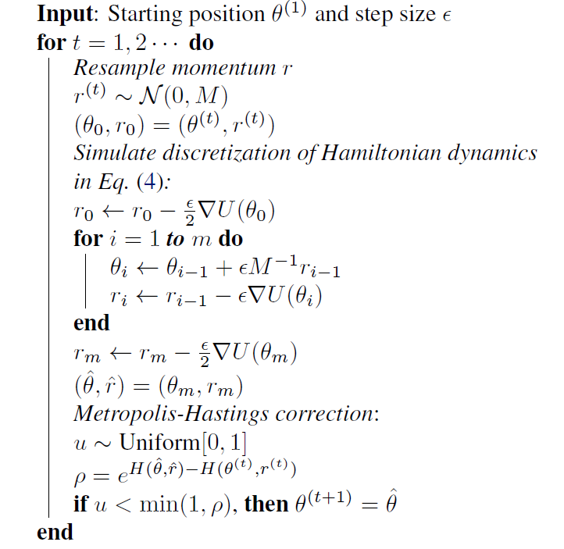
The performance of HMC depends strongly on choosing suitable values for ε and L. Imagine the consequence that a too large or too small L and ε might lead to.
Hamiltonian Monte Carlo (HMC)
What if we include the Stochastic Gradient into this algorithm?
Remember that “Stochastic” always leads to “Noise”.

Slide 9
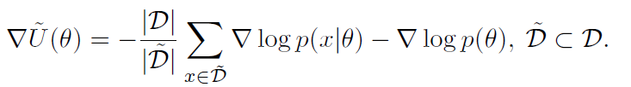

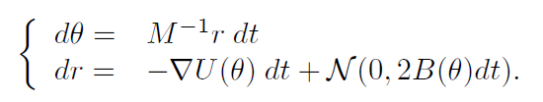

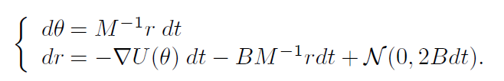
Stochastic minibatch.
V is the covariance of the stochastic gradient noise, which can depend on the current model parameters and sample size.
Gradient of Likelihood (with whole dataset.)
Naïve SG-Hamiltonian Monte Carlo
Remember that “Stochastic” always leads to “Noise”.
Will this algorithm still converge?
Recall the example of the Hockey Puck.

Slide 10
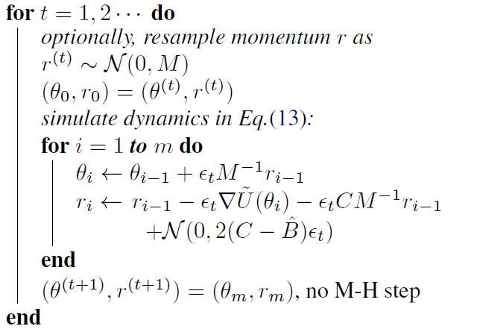
SG-Hamiltonian Monte Carlo
Remember that “Stochastic” always leads to “Noise”.
Will this algorithm still converge?
Recall the example of the Hockey Puck.
Adding a Friction term to alleviate the “Wind”.

Slide 11
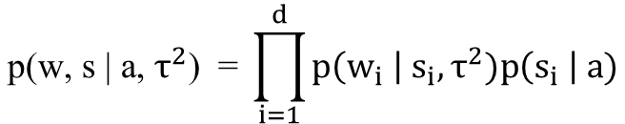

Exact Hamiltonian Monte Carlo (EHMC) with Auxiliary-variable
However, our sampling target is not always continuous.
For instance, a popular variable selection method called “the Spike and Slab Method” applied in fitting a posterior model contains parameters from discrete space.
It’s hard to use a straight forward approach to sample those discrete parameters. Then, the EHMC algorithm is introduced.
Distinguish between “discrete” and “continuous”.
- Parameter Space
- Iteration
Extension: the Spike and Slab prior and the posterior
$$\text{p}\text{(}\text{w}\text{, }\text{s}\text{ | }\text{a}\text{, }τ^{2}\text{)} \text{ = }\prod_{i=1}^{d}{p\left(w_{i} \right|{ s}_{i},τ^{2})p\left(s_{i} \right| a)}$$
- prior
How to sample from this term ?
(Binary Distribution; Discrete)
- posterior
p(w, s | D, a, $τ^{2}$) $∝$ p(D | w) p(w, s | a , $τ^{2}$)

Slide 12
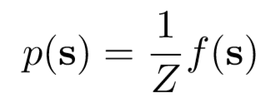

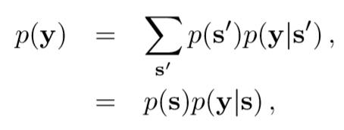
Exact Hamiltonian Monte Carlo (EHMC) with Auxiliary-variable
Exact Hamiltonian Monte Carlo (EHMC)
Sign Function: from Discrete to Continuous.
To make it simplified and intuitive, we discuss sampling from a binary distribution p(x), defined over d-dimensional space s $∈{\left\{−1,+1\right\}}^{d}$.
Let us then augment the distribution p(s) with continuous variables $y∈ℝ^{d}$ as
where p(y | s) is non-zero only in the orthant defined by
The essence of the proposed method is that we can sample from p(s) by sampling y from
p(y) is piecewise， defined in each orthant.

Slide 13


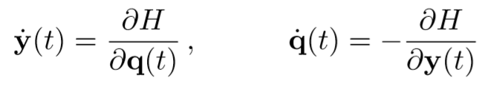
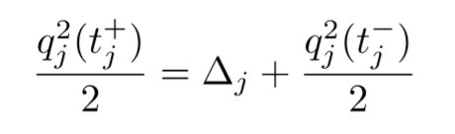








Exact Hamiltonian Monte Carlo (EHMC) with Auxiliary-variable
Exact Hamiltonian Monte Carlo (EHMC)
Two figures to illustrate the particle movement:
Still, we’re going to make use of Hamiltonian Dynamics and Hamiltonian Equation.
Please recall the previous section.
After = $\frac{q_{j}^{2}(t_{j}^{+})}{2}$ > 0
$y_{j}=0$ boundary
$$Δ_{j}$$
Before = $\frac{q_{j}^{2}(t_{j}^{−})}{2}$
$$Δ_{j}$$
$y_{j}=0$ boundary
Before = $\frac{q_{j}^{2}(t_{j}^{−})}{2}$
After = $\frac{q_{j}^{2}(t_{j}^{+})}{2}$ < 0

Slide 14
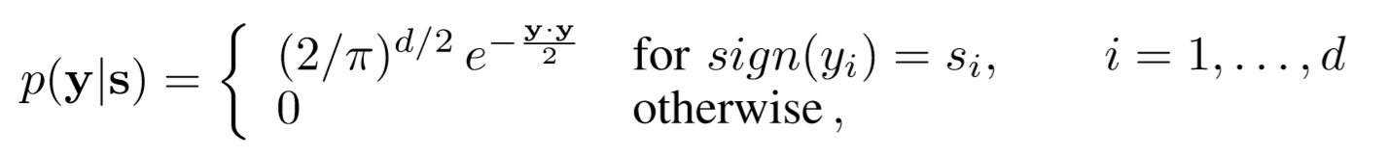

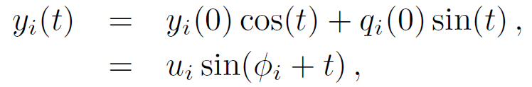



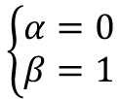
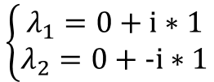

Exact Hamiltonian Monte Carlo (EHMC) with Auxiliary-variable
Exact Hamiltonian Monte Carlo (EHMC)
Choices of $p(y|s)$
A popular choice is Gaussians augmentation:
Hamiltonian Equation leads to a equation between $y\left(t\right), q\left(t\right)$ and its second derivative $\ddot{y}\left(t\right), \ddot{q}\left(t\right).$
Solving the above partial differential equations:
$$\left\{\begin{aligned}λ_{1}=0+i∗1 \\ λ_{2}=0+−i∗1\end{aligned}\right.$$
$$\ddot{y}\left(t\right)+0∗\dot{y}\left(t\right)+1∗y\left(t\right)=0$$
$$p=0, q=1$$
$$λ^{2}+0⋅λ+1=0$$
$$\left\{\begin{aligned}α=0 \\ β=1\end{aligned}\right.$$
$$y\left(t\right)=e^{α∗t}(y\left(0\right)∗\cos\left(βt\right)+q\left(0\right)∗sin⁡(βt))$$

Slide 15
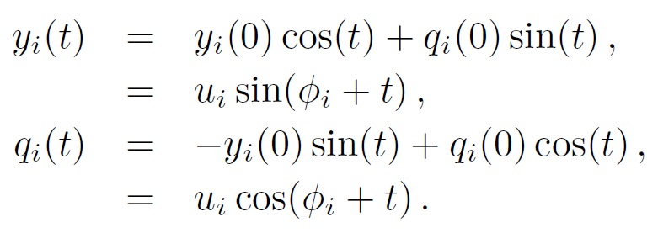
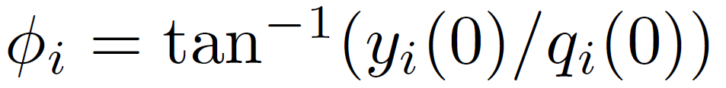
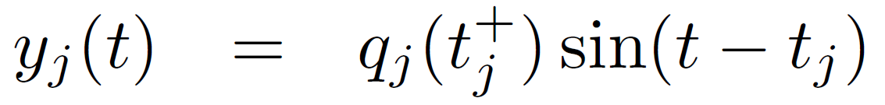




Exact Hamiltonian Monte Carlo (EHMC) with Auxiliary-variable
Exact Hamiltonian Monte Carlo (EHMC)
By solving those 2 equations we can the calculate the boundary hit times $∅_{i}$
Notation:
T = n$π$ is not recommended,
a more popular choice is
T = (n + 1/2)$π$
When a boundary is reached, say $y_{j}$, the coordinate $y_{j}$ changes its trajectory for $t>t_{j}$ as
Choosing Travel time T (Crucial):

Slide 16

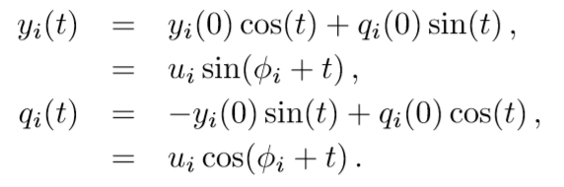
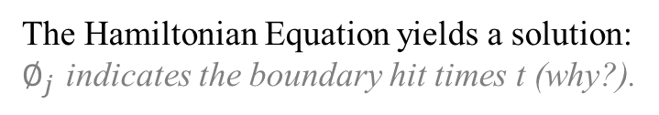
Exact Hamiltonian Monte Carlo (EHMC) with Auxiliary-variable
Exact Hamiltonian Monte Carlo (EHMC)
Truncated Gaussians augmentation
The Hamiltonian Equation yields a solution:
$∅_{j}$ indicates the boundary hit times t (why?).
Notation on implementing the algorithm
Suppose a jump of s from (1, -1, 1) to (1, 1, 1)

Slide 17

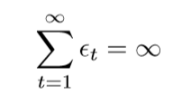
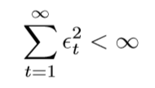
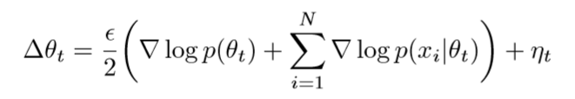

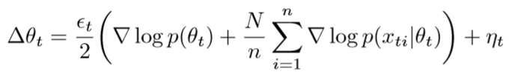

Stochastic Gradient Langevin Dynamics (SGLD)
In 1951, Robbins and Monro, to find the Maximum a Posteriori (MAP), introduced a method called Stochastic Optimization.
At each iteration t, a subset of n data items Xt = {xt1, ..., xtn} is given, and the parameters are updated as follows:
Note that 2 conditions must be satisfied.
A molecular system in the real world is unlikely to be present in vacuum. Jostling of solvent or air molecules causes friction, and the occasional high velocity collision will perturb the system. Langevin dynamics attempts to extend molecular dynamics to allow for these effects.
From above, the SGLD approach is then straightforward: use Robbins-Monro stochastic gradients, add an amount of Gaussian noise balanced with the step size used, and allow step sizes to go to zero.

Slide 18
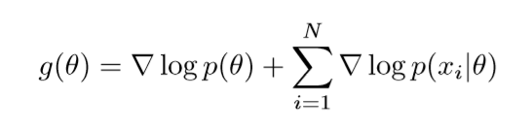
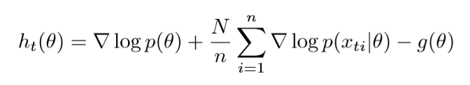
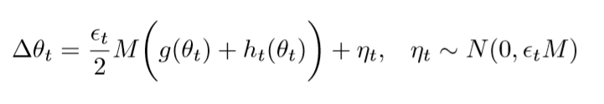
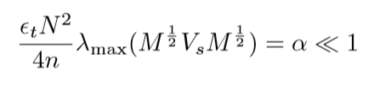
Stochastic Gradient Langevin Dynamics (SGLD)
An intuitive description:
In the initial phase the stochastic gradient noise will dominate and the algorithm will imitate an efficient stochastic gradient ascent algorithm.
In the later phase the injected noise will dominate, so the algorithm will imitate a Langevin dynamics MH algorithm (Original MH still needed?), and the algorithm will transition smoothly between the two.
TWO sources of STOCHASTICITY:
As the process going, iterate times t getting larger.
Total Stochastic Gradient dominates ?
Injected Gaussian dominates ?
In which phase can we start a sampler ?
(Threshold Introduced)

Slide 19
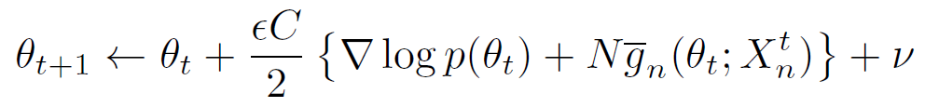

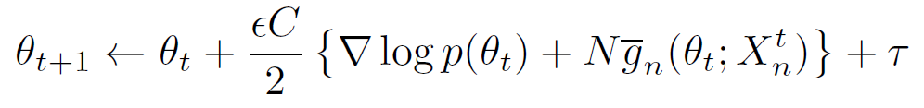
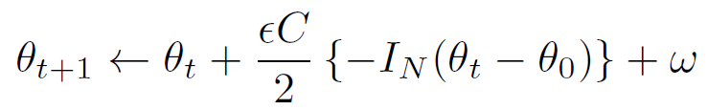
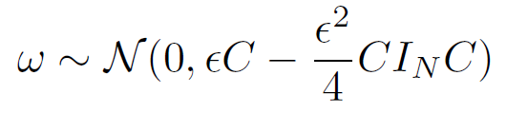
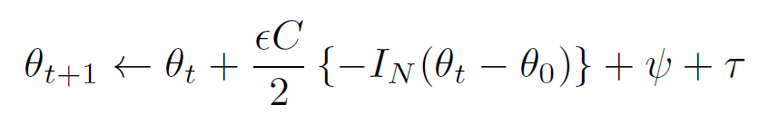
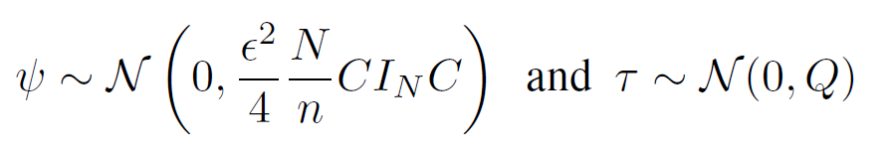
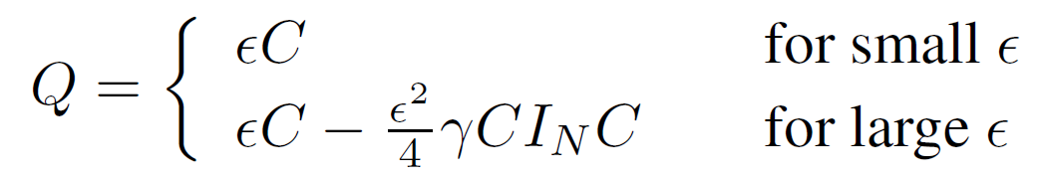
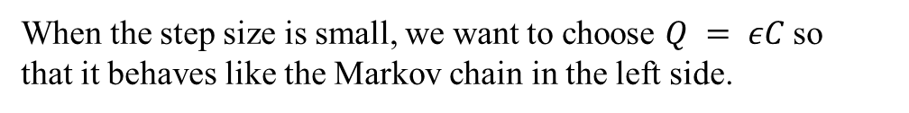
Stochastic Gradient Fisher Scoring (SGFS)
A balance between Mixing Rate & Step Size (Recall SGLD)
Goal of SGFS: design an algorithm, for large step sizes (and thus at high mixing rates) it will sample from this approximate
normal distribution (supported by the “Bayesian Central Limit Theorem” which states that when N is large the posterior will be well approximated by a normal distribution), while at smaller step sizes (and thus at slower mixing rates) it will generate samples from an increasingly accurate (non-Gaussian) approximation of the posterior.
When the step size is small, we want to choose $Q = εC$so
that it behaves like the Markov chain in the left side.
SGLD
SGLD with gradient approximated by Fisher Information
Bernstein-von Mises Approximation
“One should have the freedom to manage the right trade off between sampling accuracy and mixing rate depending on the problem at hand.”

Slide 20
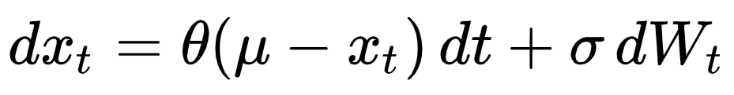


SGD as approximate Bayesian Inference
Wiener Process
Drift Coefficient
Diffusion Coefficient
A continuous-time multivariate Ornstein-Uhlenbeck process and its stationary distribution $q(θ)$:

Slide 21







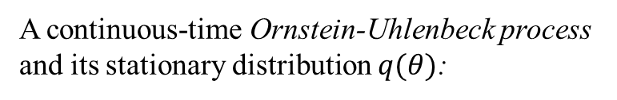
SGD as approximate Bayesian Inference
Think about the following question:
What are the similarities between SGD as an optimization algorithm and SG-MCMC methods as a sampling algorithm?
The 4 major Assumptions:
1.
Then we introduce into the SG:
2.
3.
The SGD update can be expressed as:
4.
A continuous-time Ornstein-Uhlenbeck process
and its stationary distribution $q(θ)$:
Now we are ready for yielding
the Constant Stochastic Gradient Descent algorithm.

Slide 22





SGD as approximate Bayesian Inference

Slide 23
Reference works & papers and further discussions
Reference Books:
Bayesian Data Analysis 3rd Edition
Pattern Recognition and Machine Learning
Reference Papers:
Stochastic Gradient Descent as approximate Bayesian Inference
Auxiliary-variable Exact Hamiltonian Monte Carol Samplers for Binary Distributions
Discontinuous Hamiltonian Monte Carlo for discrete parameters and discontinuous likelihoods
Bayesian Posterior Sampling via Stochastic Gradient Fisher Scoring
Bayesian Learning via Stochastic Gradient Langevin Dynamics
Exact Hamiltonian Monte Carlo for Truncated Multivariate Gaussians
Stochastic Gradient Hamiltonian Monte Carlo

Slide 24
Extension: Bernstein-von Mises Theorem & Approximation
In Bayesian inference, the Bernstein–von Mises theorem provides the basis for the important result that the posterior distribution for unknown quantities in any problem is effectively asymptotically independent of the prior distribution (assuming it obeys Cromwell's rule) as the data sample grows large.
Bernstein-von Mises Theorem
The use of prior probabilities of 0 ("the event will definitely not occur") or 1 ("the event will definitely occur") should be avoided, except when applied to statements that are logically true or false, such as 2+2 equaling 4 or 5.
Cromwell's rule

